Slide 1


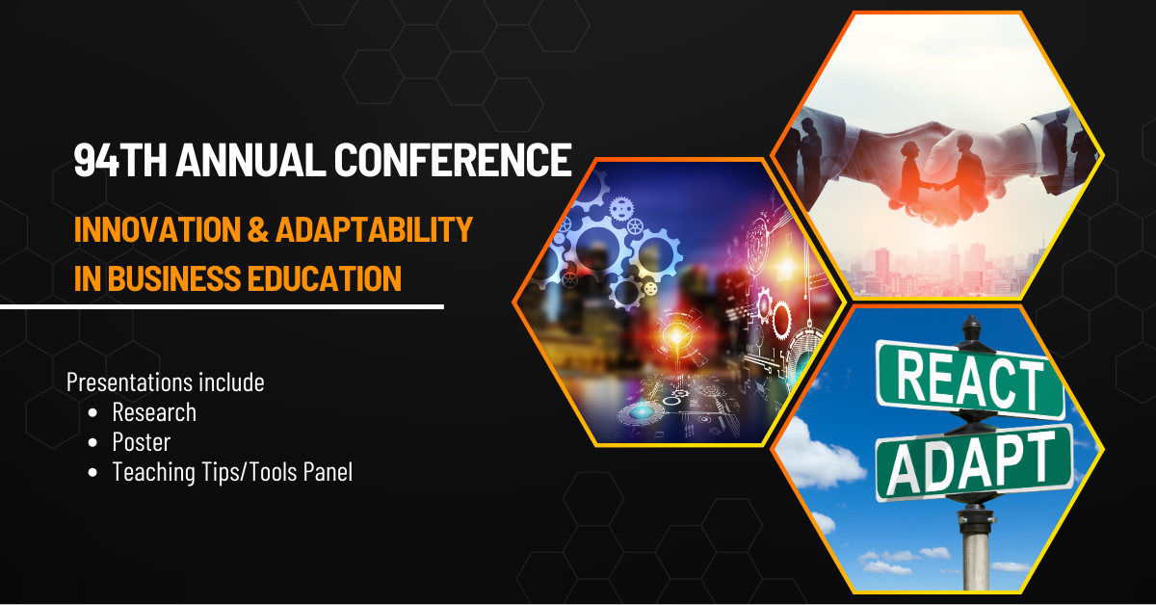
Enhancing International Business Education: The Impact of Cultural Intelligence, Global Knowledge, and Global Virtual Teams on Team Performance
Presented by Maria Randazzo-Davis, Ph.D., and Christopher Nelson, Ph.D.
SIEC Conference July 24-26, 2023

Slide 2
Abstract
In a cross-cultural environment, workers must interact with people from different cultures. This study aimed to examine the extent to which cultural intelligence and global knowledge predicted team performance for university students engaged in collaborative team projects resembling the global corporate work environment in an international business course. The sample for this study consisted of 2,012 students who participated in the X-Culture GVTP during the spring semester of 2015. The participants were members of 412 teams representing 40 countries and attending 95 universities. The researcher found from the results of this study found that global knowledge and cultural intelligence are significantly related to team performance. Also, cultural intelligence was found to be a significant, partial mediation between global knowledge and team performance in international business courses.

Slide 3
Introduction
Modern organizational success relies on competing in a globalized environment while creating new ideas, accessing innovative strategies, and effectively managing those ideas and strategies (Dereli, 2015).
While the evolution of technology will continue and poses a risk to organizations' survival. Companies' survival depends on their ability to transform the organization and compete globally (Maerki, 2008).
Technological advancements have fueled the proliferation of virtual teams, seamlessly connecting individuals from varied locations and allowing them to work together. This digital interconnectedness yields substantial benefits to an organization, enhancing productivity and fostering innovation, as asserted by Gilson et al., 2013, and further corroborated by Gilson et al., 2015).
The birth of the global virtual team (GVT) results from the manifestation of the virtual team in a cross-border scenario. A GVT can be beneficial because a virtual team reduces resource use and costs associated with the redundancy of work, time, travel, and relocation (Dekker et al., 2008; Gaeta et al., 2011; Hsu et al., 2011; Sarker et al., 2011).

Slide 4
Introduction
International business education must introduce students to global virtual team environments to prepare students for today's global collaborative business setting. It is imperative for business students to study international business as globalization continues (Aggarwal & Goodell, 2011).
University business schools and international business educators must properly educate future international business managers by creating a curriculum that provides students with the skills required to be successful in an international business environment (Eisenberg et al., 2013; Jurse & Mulej, 2011; Rehg et al., 2012).
This study addresses one university's efforts to prepare students to operate in a cross-cultural environment in a global virtual setting and the factors influencing student outcomes. Knowing how cultural intelligence and global knowledge predict team performance can help organizations avoid the problems associated with a workforce’s lack of cultural knowledge (Barnwell et al., 2014; Kiznyte et al., 2015).
The purpose of this nonexperimental correlational study was to examine the extent to which cultural intelligence and global knowledge predict team performance for university students engaged in team projects resembling the global corporate work environment.

Slide 5
Literature Review
We introduce various topics in the literature review, such as teams, GVT, the X-Culture GVTP, and the Business Cultural Intelligence Quotient (BCIQ) as they pertain to the study's purpose.
Teams
Teams are individuals who interact interdependently and have integrative accountability, empowerment, processes, and reward systems that encourage the completion of assigned tasks (Bektas & Sohrabifard, 2013; Berry, 2011; Solansky, 2011).
Teams play an important role in organizations, undertaking complex problems that require diversity in expertise to solve (Tannenbaum et al., 2012)
Managers or facilitators (educators) of teams need the knowledge and ability to prepare the team to operate in challenging situations, keep team members on track, and take necessary actions to enhance the team’s ability to work collaboratively (Cagiltay et al., 2015).
Effective teamwork has proven to be the foundation for the improvement and productivity of organizations' human capital (Bektas & Sohrabifard, 2013). The synergistic nature of teamwork creates an environment that fosters collaborative problem-solving and innovation, among numerous other advantages.

Slide 6
Literature Review
Global Virtual Teams (GVTs)
GVTs are culturally diverse groups or teams that work together to achieve goal commonality using computer-mediated technologies (Daim et al., 2012; Pinjani & Palvia, 2013).
As businesses have expanded across borders, the GVT has become a normal way to conduct business, tap into broader talent pools, leverage a 24-hour work cycle, capitalize on local knowledge, and obtain international perspectives on business challenges (Derven, 2016).
GVTs are challenged to coordinate activities at the team level, addressing team dispersion and learning how to use communication and information technologies to the team's advantage (Zander et al., 2013).
Cross-cultural training is essential to team success, and creating experiential learning, GVTP can enhance cross-cultural abilities (Duus & Cooray, 2014; Erez et al., 2013; Taras et al., 2013).
Organizations rely on Global Virtual Team Projects that collaborate with team members from various national and international borders to work on global-team projects (Henderson, Stackman, & Lindekilde, 2016; Paul et al., 2016; Zander, Zettinig, & Makela, 2013).

Slide 7
Literature Review
X-Culture GVTP
The X-Culture GVTP, developed by Professor Vasyl Taras of the University of North Carolina at Greensboro, is a virtual-team collaboration that attempts to enhance student learning in international business with information and communication technologies (Taras et al., 2012, 2013).
The X-Culture collaborative “real world” experiential teamwork project allows international business students the benefit of participating in a project that has students creating a business plan for companies that have partnered with the x-culture project and will subsequently enhance student’s understanding of and increase their cultural intelligence while meeting the challenges associated with collaborating in a global virtual environment (Taras et al., 2012).
Team sizes range from 5 to 7 students from various global locations, and these students are instructed to create a business plan for an international venture (Alon, Boulanger, Meyers, et al., 2016). Teams are exposed to various aspects of pre-project training that lead to participating in instructor-supervised projects involving activities such as research and market entry (Tullar & Taras, 2017). Student participants of the X-Culture project participate at no cost to the student; the instructor who administers the X-Culture GVTP in their course pays a fee. New fee schedule introduced -

Slide 8
Literature Review
Team Performance
Several factors impact team performance, such as cultural diversity, cultural intelligence, trust, team cohesion, technology, and geographic challenges. Cultural diversity strongly relates to team performance (Nederveen, et al., 2013). However, it is essential to analyze how diversity and team performance are handled and understood. Is the impact positive? Are there circumstances where diversity might impede performance? This could potentially occur in instances where communication issues or misunderstandings arise.
Cultural intelligence is the ability to function effectively in a culturally diverse environment (Adair, et al., 2013; Ang & van Dyne, 2008). Individual facets of cultural intelligence have a positive impact on job performance and cross-cultural effectiveness (Chen, et al., 2011; Lee, Veasna, & Wu, 2013; Ott & Michailova, 2016) and positively correlate with cultural intelligence and the effectiveness of communication (Bücker, et al., 2015; Ott & Michailova, 2016).
Moon (2013) examined the role of team-level cultural intelligence in team performance. Study results indicated that teams with increased levels of cultural intelligence also exhibited higher levels of team performance.

Slide 9
Literature Review
Business Cultural Intelligence Quotient (BCIQ)
Understanding culture through the lens of cultural intelligence helps academic and work environments proliferate the cognitive flexibility and competencies necessary to navigate the cross-cultural environment (Alon, et al., 2016; Gabrenya. et al., 2012).
The BCIQ measures cultural intelligence in a business context and relies on a sophisticated measure that combines quasi-direct observations and direct measures (Alon, Boulanger, Meyers, et al., 2016).
The BCIQ comprises four factors. The first three factors use a 5-point Likert-type scale ranging from 1 (never) to 5 (always), and the fourth-factor scale uses true and false responses (Alon, et al., 2016). The BCIQ differs from Ang and van Dyne’s (2008) four-factor model of cultural intelligence by presenting a honed factor structure, applicability to the business context, and the use of impartial cultural-knowledge measures (Alon, et al., 2016). The BCIQ includes four factors: “BCIQ1: Motivation; BCIQ2: Cross-cultural listening, communication, and adaptation; BCIQ3: Cognitive preparation; and BCIQ4: Global knowledge" (Alon, et al., 2016, p. 4).

Slide 10
Theoretical Framework
The theoretical framework chosen for this study is the cultural intelligence theory (Earley & Ang, 2003). Along with experiential-learning theory, cultural intelligence theory supports the concept that different strata or sets of groups may learn differently and can be applied to undergraduate or graduate teams.
Expanding on this, Ang and van Dyne (2008) extended Steinberg's loci to the intricate dimensions of cultural-context diversity. This adaptation identified four critical components of cultural intelligence: metacognitive CQ, cognitive CQ, motivational CQ, and behavioral CQ (Leung et al., 2014; Wang et al., 2014). However, this four-factor model of cultural intelligence has encountered challenges when applied to business contexts due to its limitations in accurately measuring cultural intelligence in such settings.
To address these constraints, researchers introduced the Business Cultural Intelligence Quotient (BCIQ) instrument. This tool was purpose-built to gauge cultural intelligence within a business framework. The design of the BCIQ utilizes sophisticated measures that combine quasi-direct observations with other established measurement techniques (Alon et al., 2016). This approach aims to overcome the limitations of prior models, such as the four-factor model of cultural intelligence.

Slide 11
Research Questions
Research Question 1: Are global knowledge and cultural intelligence related to team performance controlling for other independent variables?
H1a: Global knowledge is related to team performance controlling for other variables.
H1b: Cultural intelligence is related to team performance controlling for other variables.
Research Question 2: Do mean differences exist for global knowledge, cultural intelligence, and team performance between undergraduate student teams and teams with at least one graduate student present? The study explores the difference in these outcome variables between undergraduate student teams and graduate student teams.
Alternative hypotheses:
H2a: There is a difference in average global knowledge between undergraduate student teams and graduate student teams.
H2b: There is a difference in average cultural intelligence between undergraduate student teams and graduate student teams.
H2c: There is a difference in average team performance between undergraduate student teams and graduate student teams
Research Question 3: Is cultural intelligence a mediator between global knowledge and team performance? We are exploring the existence of a mediation effect between global knowledge and team performance.
H3a: Cultural intelligence is a significant mediator between global knowledge and team performance.

Slide 12
X-Culture Dataset
The X-Culture (2016) project administrator provided data.
Consent was obtained from the owner of the data.
No direct contact with the participants in the study.
Confidentiality of participants maintained, no information about their identity.

Slide 13
Description of the Sample
Average team size was 4.72 participants (range: 3 to 7)
22% of team members were graduate students, 88% were undergraduate students.
48% of team members were male, 52% were female
70% of teams had at least one international student.
Global knowledge average score was 60.3% correct.
Cultural intelligence mean score was 4.05 (s = 0.25) on a 5 point scale.

Slide 14
Methodology
Multiple regression analysis and independent samples t-tests using SPSS, and path analysis using LISREL.
Dependent variable: Team-performance scores.
Independent variables: Percent male, percent international, percent graduate, cultural intelligence, and global knowledge.
Significance level: α = .05.
Assumptions checked: multicollinearity, normality of residuals, homoscedasticity.
Mahalanobis distances used to identify 11 multivariate outliers resulting in a sample size of 401 teams.

Slide 15
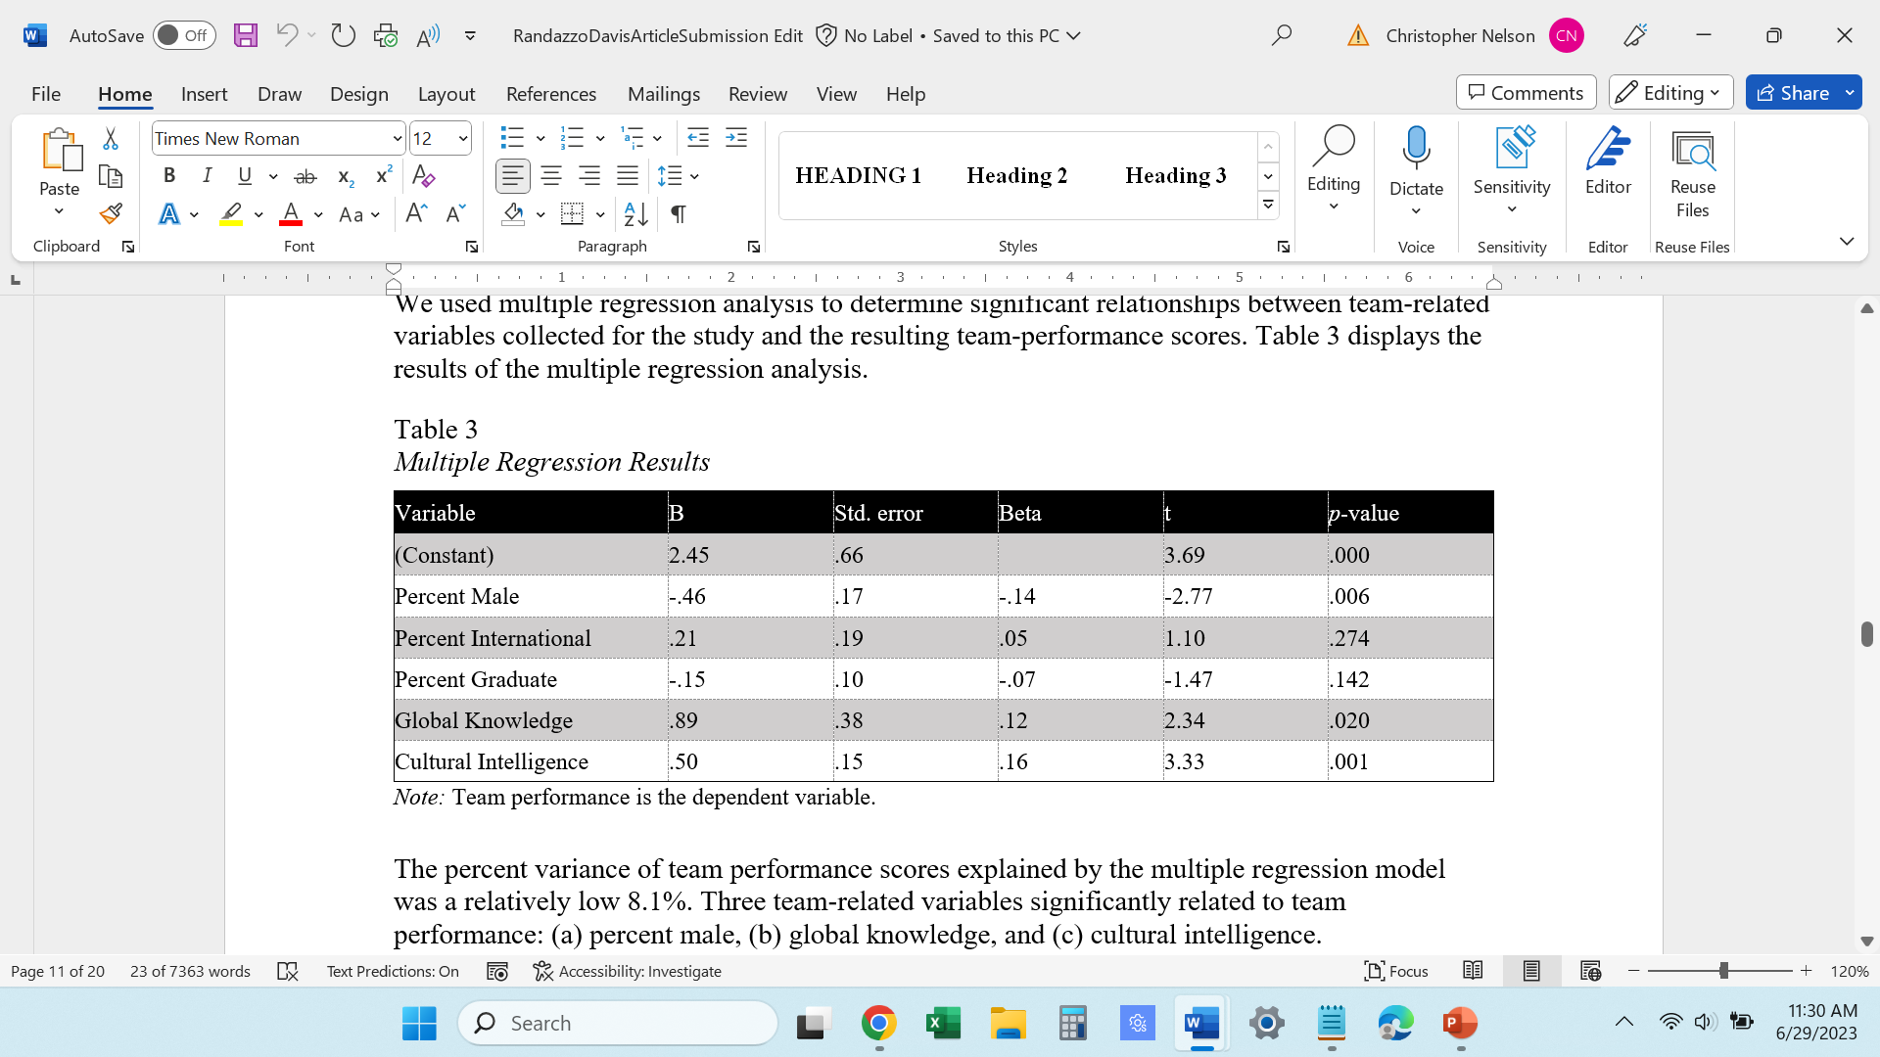
Results – Multiple Regression

Slide 16
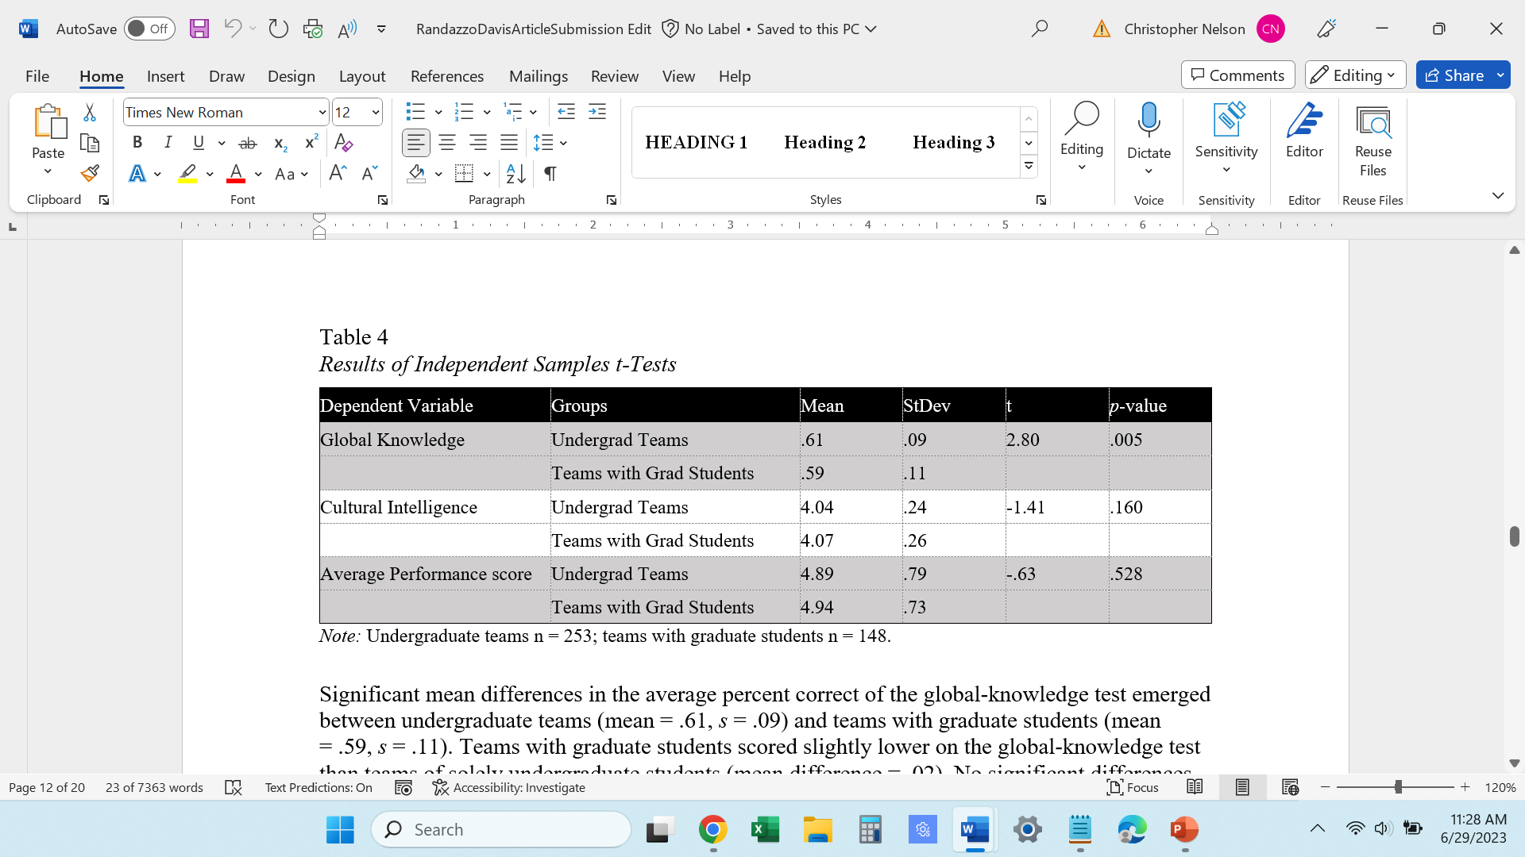
Results – Independent Samples t-tests

Slide 17
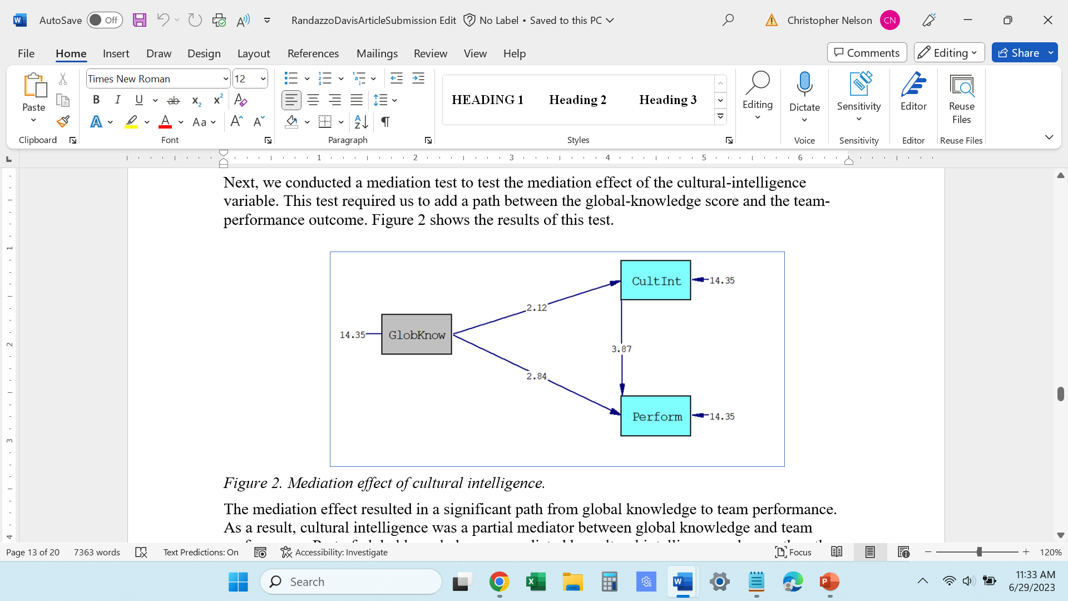
Results – Path Analysis

Slide 18
Conclusion
From the study findings, cultural intelligence and global knowledge clearly increase student teams' ability to work together and their preparedness to work in a global business environment. This is a significant finding for those involved in International Business education, as International Business courses aim to prepare students to function within a team-based computer-mediated global virtual team environment. How much this will impact business or international business education is still to be determined; ignoring these insights when creating strategies and curriculum plans would be a mistake.
Specifically, the predictor variable, cultural intelligence, related positively to the outcome variable, team performance: Cultural intelligence was a predictor of successful team performance and a mediator between global knowledge and team performance. This suggests that global businesses, universities, and various organizations, including international business educators, should be aware of and seek out greater cultural intelligence in their participants if they want better team performance. Additionally, global knowledge is related positively to team performance. This finding implies that as individuals and organizations can increase global knowledge, their chances of gaining positive team outcomes increase. Universities teaching International Business type courses must provide curricula to increase global knowledge, and businesses must consider people from academia with greater global knowledge. Business courses should carefully design curricula to broaden students’ awareness of global issues.
The research results show that cultural intelligence and global knowledge increase a team’s performance. Even though the graduate level should have had and possibly did have more educational experience, it did not necessarily impart more global understanding, which may explain findings that the difference between the two groups (undergraduate and graduate) did not affect student learning.

Slide 19
Limitations and Future Research
One limitation of this study on real-life learning in GVT was that the learning students acquired—beyond the knowledge imparted by the international-business curriculum—could not be assessed. Thus, it cannot be determined whether adding to the curriculum would be effective; however, it makes reasonable sense that anything added to the curriculum that gives students realistic learning experiences would enhance the international-business curriculum. It would be helpful to conduct a future study that discerns how the university trains international-business chairs and how the international-business instructors create a curriculum to prepare students for real-life experiences. One area to further investigate is whether the curriculum presented to students prepares them for the global corporate workforce, particularly if students are challenged to participate in realistic international-business experiences. A teaching study from this research may go to the core of international business learning curriculum development.

Slide 20
References
Adair, W. L., Hideg, I., & Spence, J. R. (2013). The culturally intelligent team: The impact of team cultural intelligence and cultural heterogeneity on team shared values. Journal of Cross-Cultural Psychology, 44, 941–962. doi:10.1177/0022022113492894
Aggarwal, R., & Goodell, J. W. (2011). Scholarship of teaching international business: Challenges and opportunities, Journal of Teaching in International Business, 22(1), 1–12. doi:10.1080/08975930.2011.585890
Alon, I., Boulanger, M., Elston, J. A., Galanaki, E., Martinez de Ibarreta, C., Meyers, J., … Velez-Calle, A. (2016). Business cultural intelligence quotient: A five-country study. Thunderbird International Business Review. Advanced online publication. doi:10.1002/tie.21826
Ang, S., & van Dyne, L. (Eds.). (2008). Conceptualization of cultural intelligence: Definition, distinctiveness, and nomological network. Handbook of Cultural Intelligence: Theory, Measurement, and Applications. Armonk, NY, US: M. E. Sharpe.
Barnwell, D., Nedrick, S., Rudolph, E., Sesay, M., & Wellen, W. (2014). Leadership of international and virtual project teams. International Journal of Global Business, 7(2), 1–8. Retrieved from http://www.gsmi-ijgb.com
Bektas, C., & Sohrabifard, N. (2013). Terms of organizational psychology, personnel empowerment and team working: A case study. Procedia—Social and Behavioral Sciences, 82, 886–891. doi:10.1016/j.sbspro.2013.06.366
Berry, G. R. (2011). Enhancing effectiveness on virtual teams. International Journal of Business Communication, 48, 186–206. doi:10.1177/0021943610397270
Bücker, J., Furrer, O., & Lin, Y. (2015). Measuring cultural intelligence (CQ): A new test of the CQ scale. International Journal of Cross Cultural Management, 15(3), 259–284. doi:10.1177/1470595815606741
Cagiltay, K., Bichelmeyer, B., & Kaplan Akilli, G. (2015). Working with multicultural virtual teams: Critical factors for facilitation, satisfaction and success. Smart Learning Environments, 2(1), Art. 11. doi:10.1186/s40561-015-0018-7Derven, M. (2016). Four drivers to enhance global virtual teams. Industrial and Commercial Training, 48(1), 1–8. doi:10.1108/ICT-08-2015-0056
Daim, T. U., Ha, A., Reutiman, S., Hughes, B., Pathak, U., Bynum, W., & Bhatla, A. (2012). Exploring the communication breakdown in global virtual teams. International Journal of Project Management, 30, 199–212. doi:10.1016/j.ijproman.2011.06.004
Derven, M. (2016). Four drivers to enhance global virtual teams. Industrial and Commercial Training, 48(1), 1–8. doi:10.1108/ICT-08-2015-0056
Duus, R., & Cooray, M. (2014). Together we innovate: Cross-cultural teamwork through virtual platforms. Journal of Marketing Education, 36, 244–257. doi:10.1177
/0273475314535783

Slide 21
References
Earley, P. C., & Ang, S. (2003). Cultural intelligence: Individual interactions across cultures. Palo Alto, CA, US: Stanford University Press.
Eisenberg, J., Lee, H.-J., Brück, F., Brenner, B., Claes, M.-T., Mironski, J., & Bell, R. (2013). Can business schools make students culturally competent? Effects of cross-cultural management courses on cultural intelligence. Academy of Management Learning and Education, 12, 603–621. doi:10.5465/amle.2012.0022
Erez, M., Lisak, A., Harush, R., Glikson, E., Nouri, R., & Shokef, E. (2013). Going global: Developing management students' cultural intelligence and global identity in culturally diverse virtual teams. Academy of Management Learning & Education, 12, 330–355. doi:10.5465/amle.2012.0200
Gabrenya, W. K., Jr., Griffith, R. L., Moukarzel, R. G., Pomerance, M. H., & Reid, P. A. (2012). Theoretical and practical advances in the assessment of cross-cultural competence. In D. D. Schmorrow & D. M. Nicholson (Eds.), Advances in design for cross-cultural activities (pp. 317–332). Boca Raton, FL, US: Taylor & Francis.
Gaeta, M., Orciuoli, F., Lola, V., & Senatore, S. (2011). A fuzzy agent-based approach to trust-based competency management. In IEEE International Conference on Fuzzy Systems (pp. 102–109). Piscataway, NJ, US: Institute of Electrical and Electronics Engineers. doi:10.1109/FUZZY.2011.6007603
Gilson, L. L., Maynard, M. T., Young, N. J., Vartiainen, M., & Hakonen, M. (2015). Virtual teams research: 10 years, 10 themes, and 10 opportunities. Journal of Management, 41, 1313–1337. doi:10.1177/0149206314559946
Henderson, L. S., Stackman, R. W., & Lindekilde, R. (2016). The centrality of communication norm alignment, role clarity, and trust in global team projects. International Journal of Project Management, 34, 1717–1730. doi:10.1016/j
.ijproman.2016.09.012
Jurse, M., & Mulej, M. (2011). The complexities of business school alignment with the emerging globalization of business education. Kybernetes, 40, 1440–1450. doi:10.1108/03684921111169477
Kiznyte, J., Ciutiene, R., & Dechange, A. (2015). Applying cultural intelligence in international project management. PM World Journal, 4(6), 202–213.
Lee, L.-Y., Veasna, S., & Wu, W.-Y. (2013). The effects of social support and transformational leadership on expatriate adjustment and performance: The moderating roles of socialization experience and cultural intelligence. Career Development International, 18, 377–415. doi:10.1108/CDI-06-2012-0062
Maerki, H. U. (2008). Are business schools studying and teaching the right things? Journal of Management Development, 27, 425–430. doi:10.1108/0262710810866769

Slide 22
References
Moon, T. (2013). The effects of cultural intelligence on performance in multicultural teams. Journal of Applied Social Psychology, 43, 2414–2425. doi:10.1111/jasp.12189
Nederveen Pieterse, A., van Knippenberg, D., & van Dierendonck, D. (2013). Cultural diversity and team performance: The role of team member goal orientation. Academy of Management Journal, 56, 782–804. doi:10.5465/amj.2010.0992
Ott, D. L., & Michailova, S. (2016). Cultural intelligence: A review and new research avenues. International Journal of Management Reviews, 20(1), 1–21. doi:10.1111/ijmr.12118
Paul, R., Drake, J. R., & Liang, H. (2016). Global virtual team performance: The effect of coordination effectiveness, trust, and team cohesion. IEEE Transactions on Professional Communication, 59, 186–202. doi:10.1109/TPC.2016.2583319
Rehg, M. T., Gundlach, M. J., & Grigorian, R. A. (2012). Examining the influence of cross-cultural training on cultural intelligence and specific self-efficacy. Cross-Cultural Management: An International Journal, 19, 215–232. doi:10.1108/13527601212219892
Sarker, S., Ahuja, M., Sarker, S., & Kirkeby, S. (2011). The role of communication and trust in global virtual teams: A social network perspective. Journal of Management Information Systems, 28(1), 273–309. doi:10.2753/MIS0742-1222280109
Solansky, S. T. (2011). Team identification: A determining factor of performance. Journal of Managerial Psychology, 26, 247–258. doi:10.1108/0683941111112677
Taras, V., Caprar, D., Rottig, D., Sarala, R., Zakaria, N., Zhao, F., … Huang, V. (2013). A global classroom? Evaluating the effectiveness of global virtual collaboration as a teaching tool in management education. Academy of Management Learning & Education, 12, 414–435. doi:10.5465/amel.2012.0195
Taras, V., Bryla, P., Forquer, S., Jimenez, A., Minor, M., Muth, T., … Zdravkovic, S. (2012). Changing the face of international business education: The X-Culture project. Academy of International Business Insights, 12, 11–17. Retrieved from https://libres.uncg.edu/ir/uncg/f/R_Sarala_Changing_2012.pdf
Tullar, W. L., & Taras, V. (2017). Free riding: A multi-cultural study. International Journal of the Academic Business World, 11(1), 39–48.
Zander, L., Zettinig, P., & Makela, K. (2013). Leading global virtual teams to success. Organizational Dynamics, 42, 228–237. doi:10.1016/j.orgdyn.2013.06.008

