Slide 1
Identifying gaps in the higher education student experience
Mary Millikin, Ph.D.
Rogers State University
2023 SIEC-ISBE Conference: July 25, 2023
Notes:
NOTE:
To change the image on this slide, select the picture and delete it. Then click the Pictures icon in the placeholder to insert your own image.

Slide 2
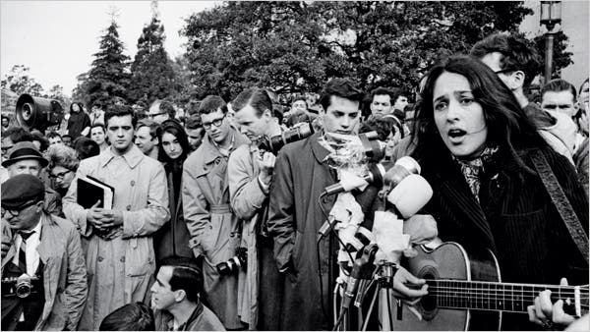
Times Are A-changing
Rick Perlstein states in his article, "What's the Matter with College?" that college should be a time of self-discovery – a gateway into to adulthood where one develops a sense of freedom and discovers identity.
Berkeley, Baez, 1964: Times have changed. Credit...Ted Streshinsky
Source: In text citation. Kibin. (2023). An analysis of the legitimacy of college in what's the matter with college by Rick Perlstein.

Slide 3
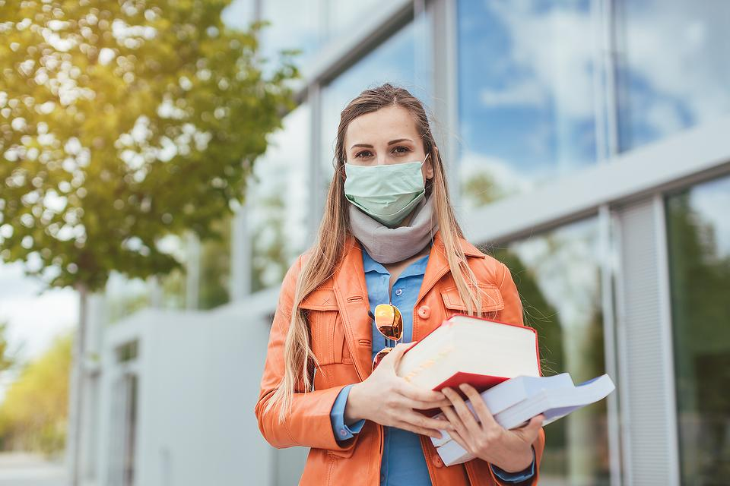
But is it?
https://www.blogger.com/blogin.g?blogspotURL=https://lindasidharta.blogspot.com/2021/07/stress-among-university-students-stress.html&type=blog

Slide 4
Historical Full-time College Enrollment
Increased after WWII with GI bill and Baby Boomers
Continued increase through 1970s (college preferred to Viet Nam by many)
Rise again beginning in 1990s with push for access and attainment
Drop began in 2010 with change in perspective of value of college education
Source: US Department of Education

Slide 5
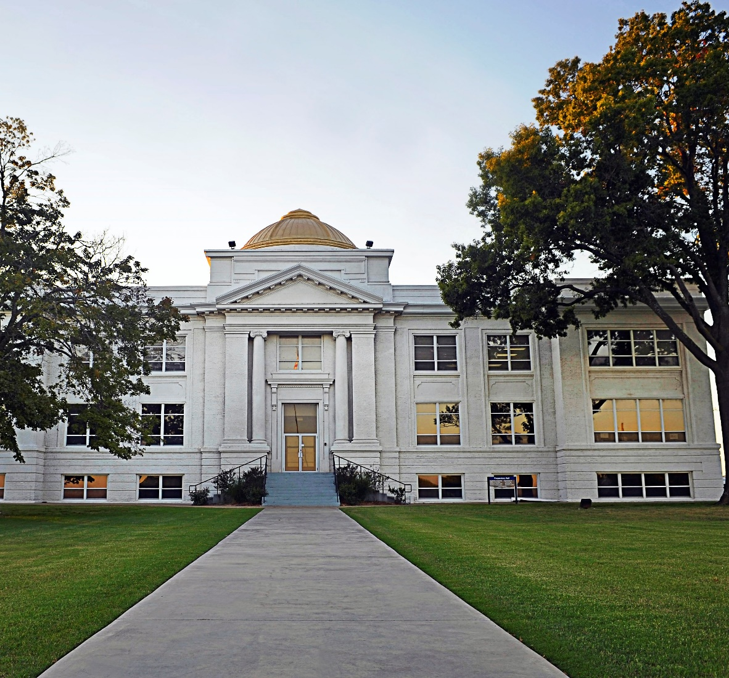
Why?
Public confidence in higher education has fallen in recent years, with approximately half of Americans seeing it in a positive light. Yet polling shows that people are far more likely to view their local college favorably, a perception that may be reflective of “Town and Gown” interactions with hometown institutions (e.g., real-estate developers, arts-and-culture magnets, civic conveners, and public-health champions.

Slide 6
Questions to Reflect On
College education is viewed as less necessary by many adults. Why?
Those who enroll in college have increasingly relied on student loans, accruing unprecedented levels of student debt. How do we help those who choose to go to college be successful?
How do we challenge our perspective rather than approach student success with one size fits all?
What can regional institutions do today and in the future?

Slide 7
Who is attending college?
First-time freshmen
College-going high school graduates are declining
Continuing adult students are completing with market saturation
Fewer part-time students who are choosing full-time work and avoiding student loan debt
Fewer associate degree seeking students who are choosing full-time work and avoiding student loan debt

Slide 8
Changing Landscape
Culture
Job/Career focus more than self-discovery
Less social value placed on college degree
Disillusionment with student loan debt at graduation
Traditional Vs. Non-Traditional
Population of graduating high school students is declining
Significant online shift
Decrease in part-time students and associate degree students who are more likely to pursue full-time employment
Gender and Race/ Ethnicity
Slower decline for females than males; 58% to 42% (DOE)
Increase in Hispanic/ Latino although not as high as overall population
Increase in Asian students although no increase in overall US population
“Contemporary” adult student population is reaching saturation
Bestcolleges.com: Data Summary. In 2021, 11.2 million college students (60%) took at least one class online. That's a decrease from 2020, when 14.2 million college students (75%) took at least one class online. About 8.9 million students (47%) take college classes exclusively online.

Slide 9
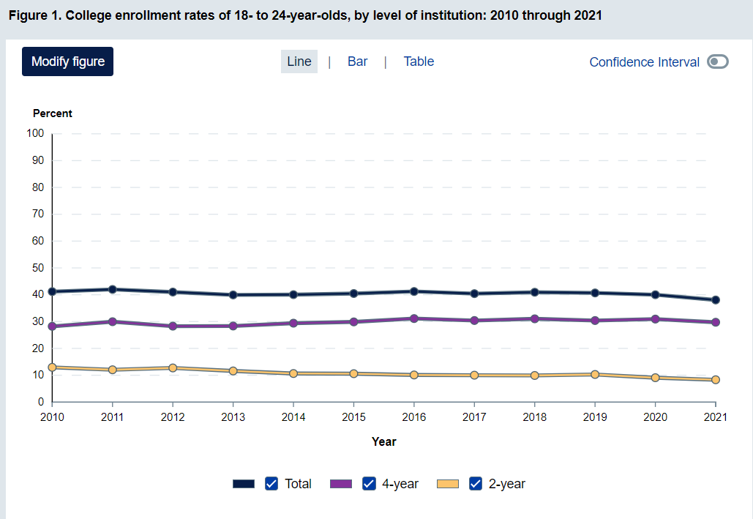
Overall College Enrollment Rates by Institution Level
Source: National Center for Education Statistics (May 2023)

Slide 10
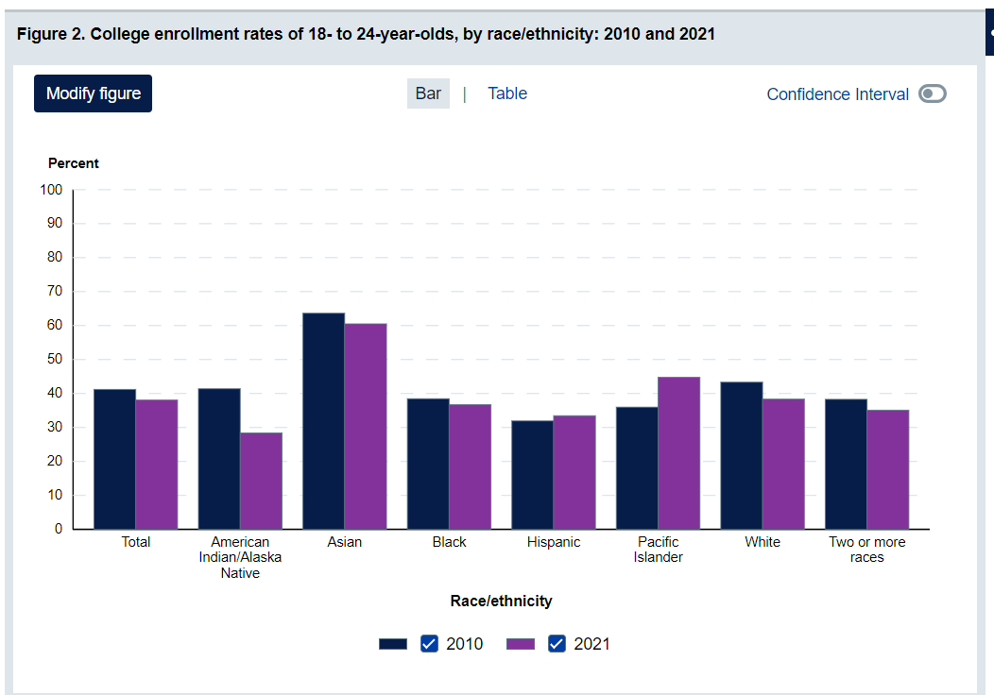
Race/Ethnicity
Source: National Center for Education Statistics (May 2023)

Slide 11
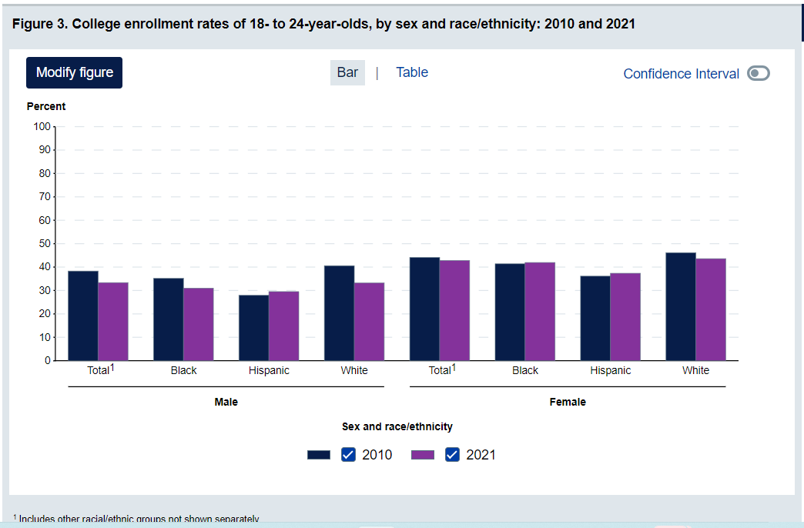
Gender and Race/Ethnicity
Source: National Center for Education Statistics (May 2023)

Slide 12
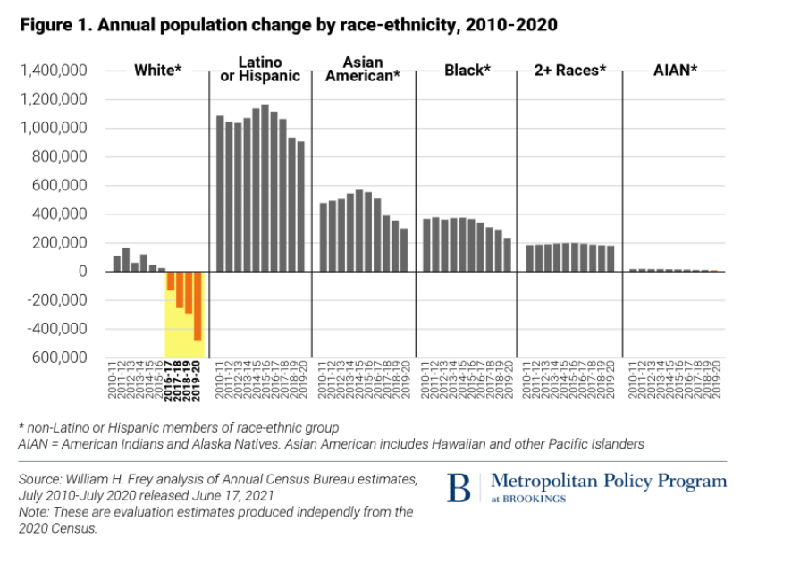
Compared to Overall US Population Trend Same Period?
Source: National Center for Education Statistics (May 2023)

Slide 13
Perspective of student experiences at 4-year university
What is Important? What are they satisfied with? What are the gaps? How can this lead to greater student success?

Slide 14
How Satisfied Are College Students?
And how likely are they to re-enroll?

Slide 15
Nationally: How Satisfied Are Students by Institution Type

Slide 16
Nationally: How Likely Are Students to Re-enroll by Institution Type

Slide 17
RNL Student Satisfaction Inventory: Spring 2022 N = 524

Slide 18
Student Satisfaction Inventory: Spring 2022 All Respondents, N = 524: upper right quadrant
Campus is safe and secure for all students.
There is an adequate selection food in cafeteria.
The intercollegiate athletic programs contribute to a strong sense of school spirit.
There are a sufficient number of weekend activities.
A variety of intramural activities are offered.

Slide 19
But What Are Learners’ and Their Future Employers’ Unique Needs?

Slide 20
Gender: College Experience Met Expectations
Sample mean = 4.77

Slide 21
Gender: Overall Satisfaction
Sample mean = 5.46; Transgender and Genderqueer mean response statistically significant at alpha = .05)

Slide 22
Gender: Preference to Re-enroll
Sample mean = 5.61

Slide 23
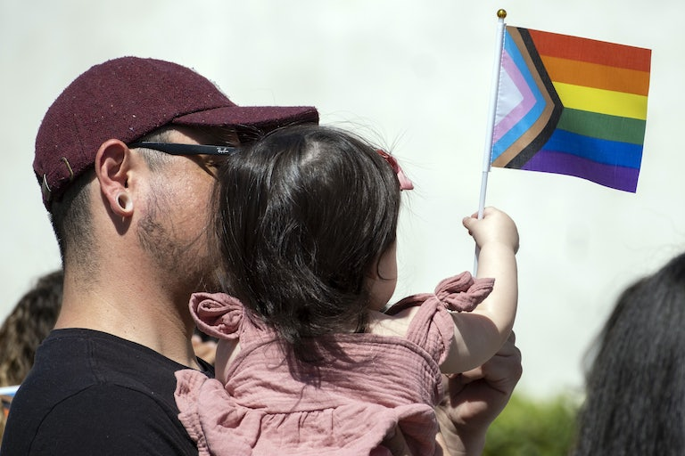
Transgender and Genderqueer Student Perspective
Highest Satisfaction
#6 My Academic Advisor is approachable (6.433)
#13 Library staff are helpful and approachable (6.86)
#23 Living conditions in residence halls are comfortable (6.33)
#26 Computer labs are adequate and accessible (6.25)
#35 The assessment and course placement procedures are reasonable (6.29)
#54 Bookstore staff are helpful (6.25)
Lowest Satisfaction
#4 Admissions staff are knowledgeable (4.14)
#17 Adequate financial aid is available for most students (3.43)
#43 Admissions counselors respond to prospective students’ unique needs and requests (4.14)
#48 Admissions counselors accurately portray the campus in their recruiting practices (4.17)
Other indicators
#1 Most students feel a sense of belonging here (5.10 compared to 5.46 all) Not sig at alpha = .05
#7 The campus is safe and secure for all students (5.71 compared to 6.32 all) Not sig at alpha = .05

Slide 24
Male Student Perspective
Highest Satisfaction
Females
#31 Males and Females have equal opportunities to participate in intercollegiate athletics (6.4)
#50 Class change policies are reasonable (6.37)
#65 Faculty are usually available after class and during office hours (6.21)
#76 Students learn to use written, oral, and visual communication effectively (6.32)
#77 Students develop an individual perspective on the human experience and demonstrate and understanding of diverse perspectives (6.23)
Males
#7 Campus is safe and secure for all students (6.18)
#13 Library staff are helpful an approachable (6.19)
#33 My Academic Advisor is knowledgeable about requirements in my major (6.01)
Lowest Satisfaction
Females
#42 Sufficient number of weekend activities for students (4.90)
Males
#42 Sufficient number of weekend activities for students (4.26)
#38 Adequate selection of food available in cafeteria (4.77)
#40 Residence hall regulations are reasonable (4.86)
#71 Channels for expressing student complaints are readily available (4.87)
#73 Activities fees are put to good use (4.78)

Slide 25
Gender Conclusions
All genders expressed general satisfaction with the college experience, including safety and academic experience
Females reported highest satisfaction with all areas
Males were most concerned with out-of-class experiences including residential life, extracurricular activities, and channels to express complaints
Transgender and genderqueer students expressed more concern with the admissions experience. Although expectations were met, expectations may not as high.

Slide 26
Race and Ethnicity: College Experience Met Expectations
Sample mean = 4.77; no significant difference at alpha = .05

Slide 27
Race and Ethnicity: Overall Satisfaction
Sample mean = 5.46; no significant difference at alpha = .05

Slide 28
Race and Ethnicity: Preference to Re-enroll
Sample mean = 5.61; no significant difference at alpha = .05

Slide 29
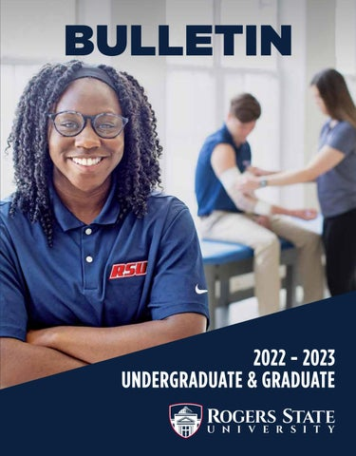
Race and Ethnicity Student Perspective
Highest Satisfaction for Black/African students
#7 The campus is safe and secure for all students (6.60)
#13 Library staff are helpful and approachable (6.65)
#15 The staff in health services area are competent (6.45)
#18 Library resources and services are adequate (6.61)
#22 Counseling staff care about students as individuals (6.60)
#6 My academic advisor is approachable (5.87)
Lowest Satisfaction for Black/African Students
#9 A variety of intramural activities are offered (4.93)
#11 Billing policies are reasonable (4.94)
#38 There is an adequate selection of food available in the cafeteria (4.20)
#42 There are a sufficient number of weekend activities for students (3.91)
#49 There are adequate services to help me decide on a career (4.55)
Not significant at alpha = .05

Slide 30
Race and Ethnicity Conclusions
All races and ethnicity expressed general satisfaction with the college experience
Lowest satisfaction (still above midpoint) for all races and ethnicity was sufficient weekend activities
Although no statistically significant difference, Black and African American students reported lower mean satisfaction than other races with Multi-racial students reporting the highest mean satisfaction.
Highest satisfaction was achieved across racial and ethnicity categories for:
Safety and security on campus
Library staff and Library services
Counseling services
Academic Advisement
Hispanic students reported higher satisfaction and importance for admission staff focusing on their unique needs

Slide 31
Age: College Experience Met Expectations
Sample mean = 4.8; significant difference at alpha = .05

Slide 32
Age: Overall Satisfaction
Sample mean = 5.5

Slide 33
Age: Preference to Re-enroll
Sample mean = 5.6; significant difference at alpha = .05

Slide 34
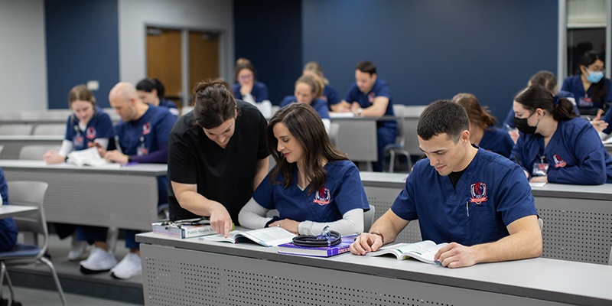
Age Student Perspective
Highest Satisfaction for all students
#5 Financial aid counselors are helpful (6.19)
#7 The campus is safe and secure for all students (6.31)
#18 Library resources and services are adequate (6.24)
#65 Faculty are usually available after class and during office hours (6.13)
#76 Students learn to use written, visual, and oral communication effectively (6.16)
Lowest Satisfaction (Traditional students sophomores through seniors)
19-24 years
#38 There is an adequate selection of food available in the cafeteria (4.82)
#42 There are a sufficient number of weekend activities for students (4.54)
25-34 years
#57 I seldom get the run-around when seeking information on this campus (5.00)
#73 Student activity fees are put to good use (5.00)

Slide 35
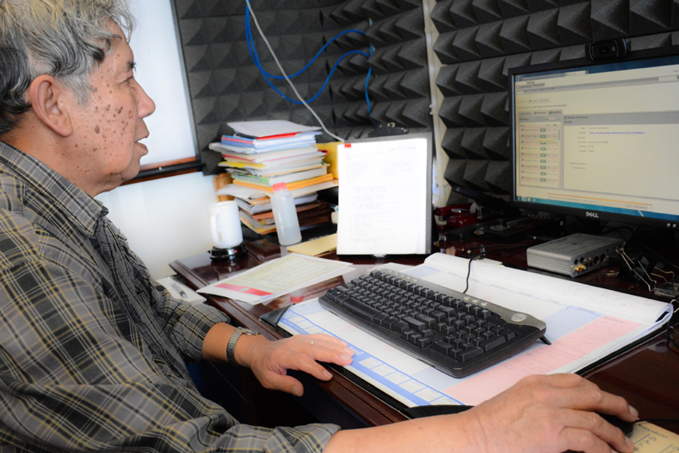
Age Conclusions
All genders expressed general satisfaction with the college experience, including safety and academic experience
Traditional age students expressed less strong satisfaction with out-of-class activities and experiences
Non-traditional/contemporary students reported strongest satisfaction

Slide 36
Degree Type/Goal
All degree levels view their experiences positively, with Associate degree seekers on the lower boundary, suggesting additional challenges
Certificate seekers perceive their experiences most positively
Item | Associate | Bachelor’s | Master’s | Certificate | Overall
So far has your college experience met your expectations? | 4.45 | 4.79 | 4.80 | 7.0 | 4.77
Rate your overall satisfaction with your experience here thus far * | 4.81* | 5.50 | 5.43 | 7.0 | 5.45
All in all, if you had to do it over again, would you enroll here? * | 5.10* | 5.65 | 5.50 | 6.0 | 5.61

Slide 37
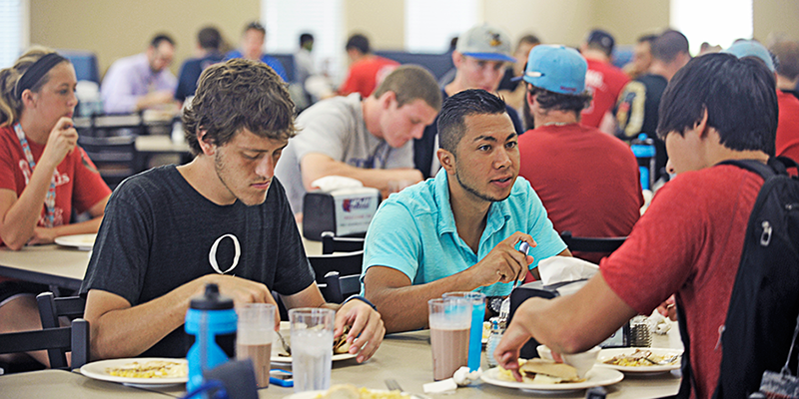
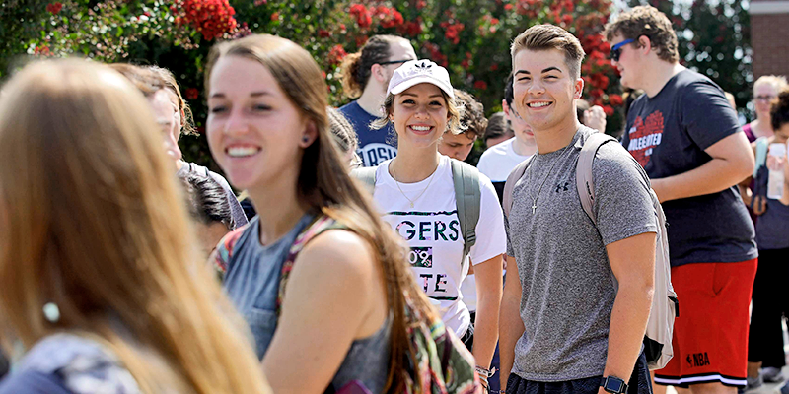
Disability, Employment, and Residence
Disability: No significant or important differences by self-reported disability designation (N=62)
Students with identified disability averaged slightly higher intention to re-enroll than those not reporting a disability
Current Residence: Students living off-campus, whether owning their own home or living with parents, reporting slightly higher intentionality for re-enrollment
Employment: Those not employed and those employed in general reported no significant difference in satisfaction or re-enrollment intention.
Students who were employed part-time only on-campus (N=44) reported higher than midpoint satisfaction but reported lesser satisfaction than other employment groups.

Slide 38
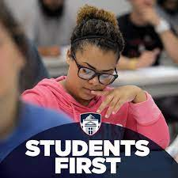
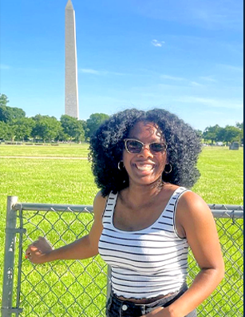
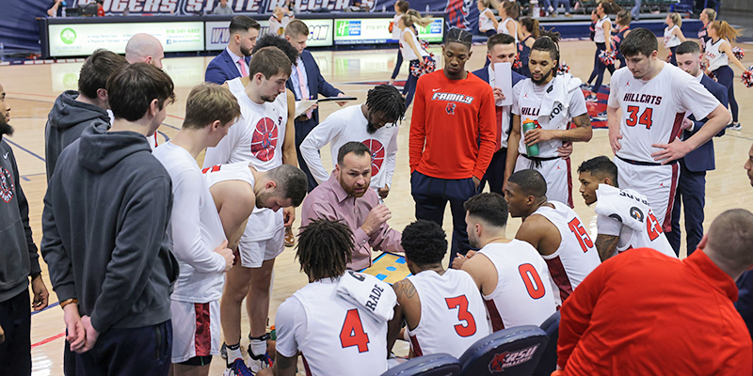
Honors Program, Athletic Program
Honors Program
No significant or important differences
N=99; nearly 100% of Honors students
Athletic Program:
No significant or important differences
N=106; 50% of athletes

Slide 39
What Is Most Important?
Item | Mean Importance | Mean Satisfaction | Gap
Campus is safe and secure | 6.72 | 6.32 | 0.40
Faculty knowledgeable in field | 6.69 | 6.07 | 0.62
Able to register for classes with few conflicts | 6.68 | 5.89 | 0.79
Academic advisor is knowledgeable | 6.67 | 6.02 | 0.65
Security staff respond quickly in emergencies | 6.63 | 6.02 | 0.61
Good variety of courses provided on this campus. | 6.63 | 5.97 | 0.69
Experience intellectual growth | 6.62 | 5.65 | 0.66

Slide 40
What Is Least Important Overall?
Item | Mean Importance | Mean Satisfaction | Gap
A variety of intramural activities are offered. | 5.43 | 5.48 | -0.06
There are sufficient number of weekend activities for students | 5.62 | 4.79 | 0.83
Intercollegiate athletic programs contribute to school spirit | 5.79 | 5.57 | 0.22
I generally know what’s happening on campus | 6.10 | 5.55 | 0.55

Slide 41
Conclusions and recommendations

Slide 42
Take-Aways
What is most valued by all?
Safe learning and living environment
Strong Library staff and resources
Friendly, helpful Services (e.g., Counseling Services, Bookstore)
Knowledgeable advisors in major and general studies

Slide 43
Take-Aways
Where is unique attention needed:
Gender-specific needs such as with transgender learners in Admissions and with male, on-campus learners who desire more engaging, weekend activities
Race-specific needs such as African American, on-campus learners who desire clearer financial aid and billing information and career services
On-campus living enhancements beginning with sophomores and upper classmen

Slide 44
Take-Aways
Where is unique attention needed:
Associate degree-seekers are likely to demonstrate lower persistence. Additional investigation is needed to resolve this issue.
Non-traditional, contemporary learners as well as online learners appear to be strongly satisfied. They can be easily overlooked, and additional research is appropriate.

Slide 45
Times are changing: Recommendations
Provide training for unique student needs! Demonstrate that these learners are valued! One size does not fit all.
Develop partnerships with employers and community groups that are reciprocal, not paternalistic.
Determine how colleges can act as “quarterback organizations” that coordinate goals, strategies, and investments for a community.
Commit to emphasizing lifelong education by strengthening ties to K-12 schools and offering job training and non-degree credentials to meet local economic needs.
Chronicle of Higher Education (July, 2023)
https://ethicalboardroom.com/changing-times/

Slide 46
We must adjust to changing times and still hold to unchanging principles.
J. Carter

Slide 47
Q&A
Notes:
NOTE:
To change the image on this slide, select the picture and delete it. Then click the Pictures icon in the placeholder to insert your own image.

